Slide 1
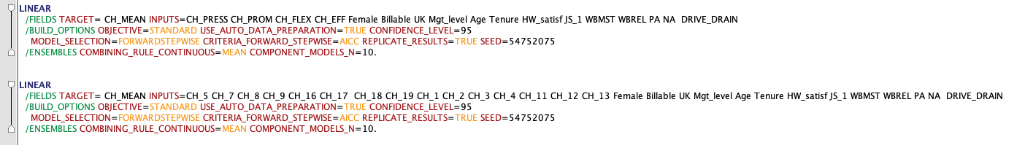
Model 1
Model 2

Slide 2
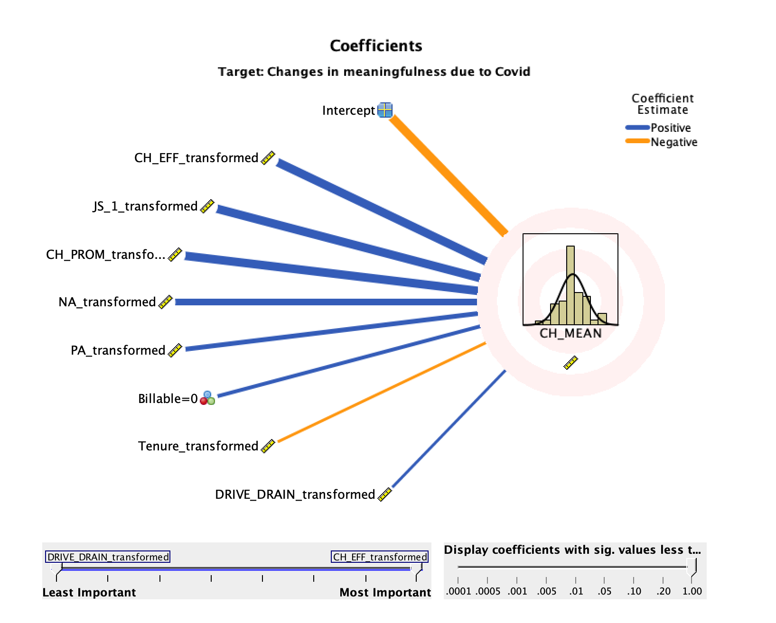
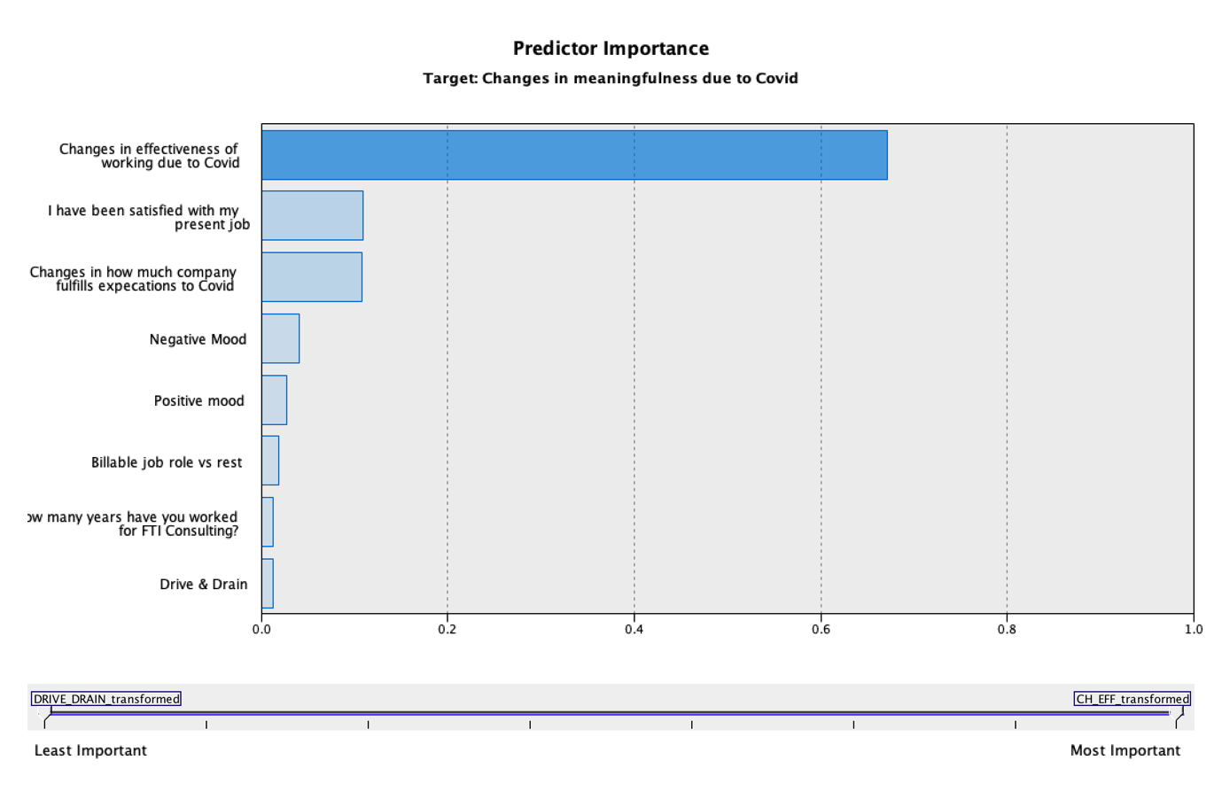
Model 1

Slide 3
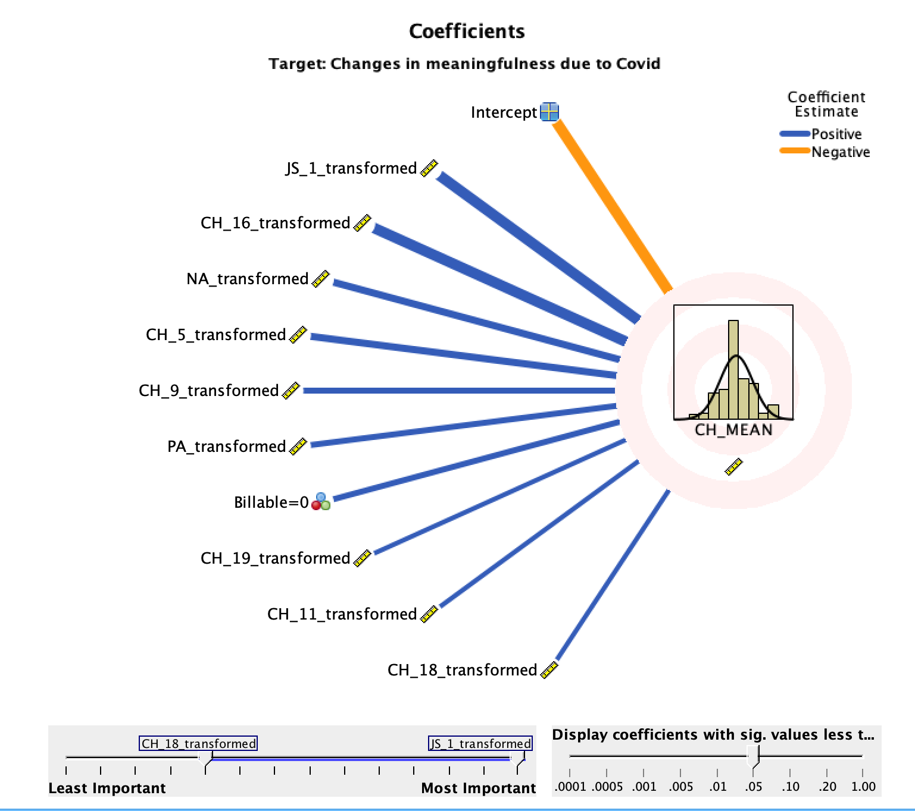
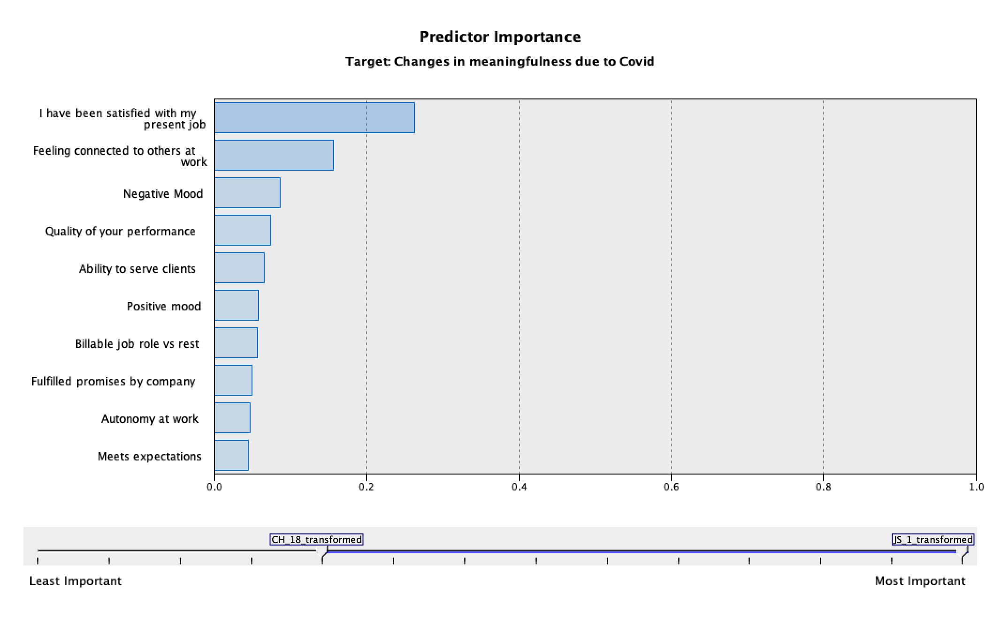
Model 2
CH_EFF ?
CH_EFF
CH_EFF
CH_PROM
CH_FLEX
CH_PROM
Notes:
Some notes:
Job satisfaction strongest predictor (though of course causality issues)
Effectiveness and Fulfils Expectations measures are good predictors of meaningfulness, while Work Pressures and Flexibility are not (barring CH_11 Autonomy at work)
Interesting that the direct ”Effective working” CH_7 measure does not predict, though other effective working measures are NB
”Feeling connected to others at work” CH_16 is part of the CH_EFF factor but feels different to others (as does CH_17). This is obvs a big contributor to the CH_EFF dominance in model 1. Should this be part of the same factor?
CH_11 (Autonomy at work) is a predictor; in another model I dropped this and used the AUT factor instead, which also gets similar results (a sig predictor, but low on the scale)

